Slide 1
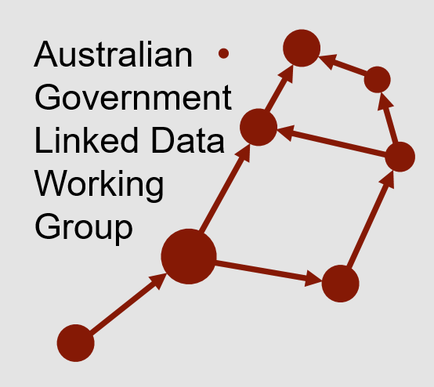

New methods of governing Linked Data
Nicholas Car
Co-Chair AGLDWG, Senior Experimental Scientist, CSIRO
For the Open Data Community Meet-up, 2018-07-20

Slide 2
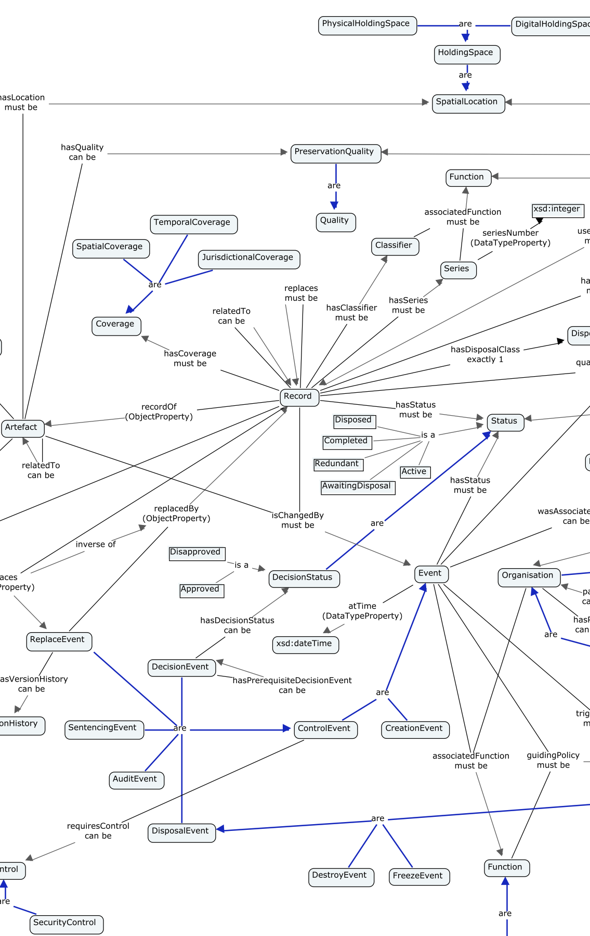
Outline
Defining Linked Data
The Aust Govt Linked Data WG
Things the AGLDWG does
Linked Data catalogue
Aust Govt Integrated Set of Ontologies
Exemplar project – LOC-I

Slide 3
Defining Linked Data
"Linked Data" refers to a set of standards, practices, and tools for publishing and linking structured data on the Web
Data that is Linked Data is linked to other data and can in turn be linked from other data
It is data that is published in a machine-readable way because all data is explicitly described in meaning and in format.

Slide 4
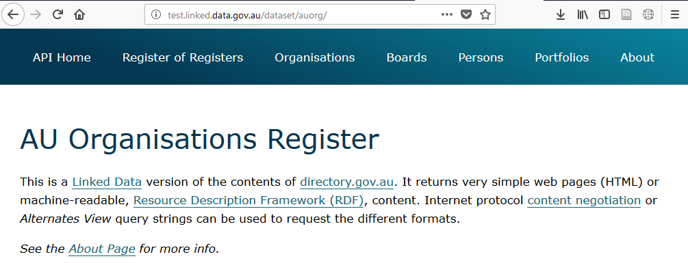
Defining Linked Data
An example Linked Data dataset…

Slide 5
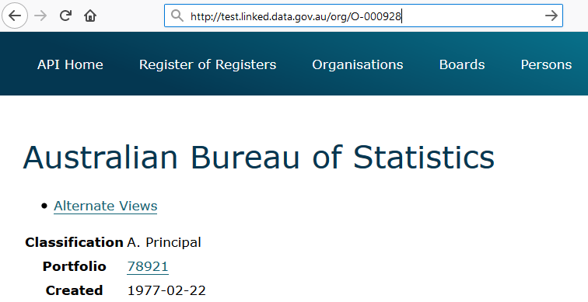
Defining Linked Data
One item in that dataset…

Slide 6
Defining Linked Data
One item in that dataset…
<http://test.linked.data.gov.au/org/O-000928> a org:Organization ;
rdfs:label "Australian Bureau of Statistics" ;
auorg:averageStaffingLevel 2387 ;
auorg:budgetAppropriations "368919000"^^auorg:AustralianDollars ;
auorg:portfolio <http://test.linked.data.gov.au/portfolio/78921> ;
dct:created "1977-02-22"^^xsd:date ;
dct:description "The ABS is..." ;
ns2:hasStreetAddress <http://gnafld.net/address/GAACT714857871> ;

Slide 7
Defining Linked Data
One item in that dataset…
<http://test.linked.data.gov.au/org/O-000928> a org:Organization ;
rdfs:label "Australian Bureau of Statistics" ;
auorg:averageStaffingLevel 2387 ;
auorg:budgetAppropriations "368919000"^^auorg:AustralianDollars ;
auorg:portfolio <http://test.linked.data.gov.au/portfolio/78921> ;
dct:created "1977-02-22"^^xsd:date ;
dct:description "The ABS is..." ;
ns2:hasStreetAddress <http://gnafld.net/address/GAACT714857871> ;

Slide 8
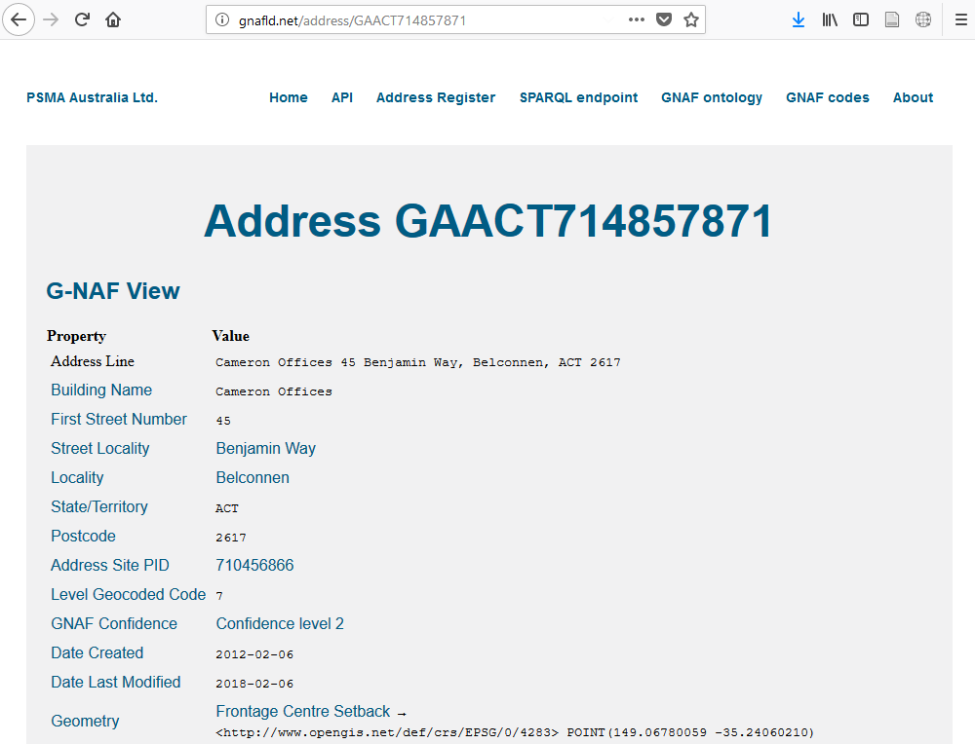
Defining Linked Data
Following that link…
<http://test.linked.data.gov.au/org/O-000928> a org:Organization ;
rdfs:label "Australian Bureau of Statistics" ;
auorg:averageStaffingLevel 2387 ;
auorg:budgetAppropriations "368919000"^^auorg:AustralianDollars ;
auorg:portfolio <http://test.linked.data.gov.au/portfolio/78921> ;
dct:created "1977-02-22"^^xsd:date ;
dct:description "The ABS is..." ;
ns2:hasStreetAddress <http://gnafld.net/address/GAACT714857871> ;

Slide 9
Defining Linked Data
And the result in machine-readable form…
<http://gnafld.net/address/GAACT714857871> a gnaf:Address ;
gnaf:hasBuildingName "Cameron Offices"^^xsd:string ;
gnaf:hasGnafConfidence <gnaf/GnafConfidence_2> ;
gnaf:hasLocality <http://gnafld.net/locality/ACT559> ;
gnaf:hasNumber [ a gnaf:Number ;
gnaf:gnafType <gnaf#FirstStreet> ;
prov:value 45 ] ;
gnaf:hasPostcode 2617 ;
gnaf:hasState <http://www.geonames.org/2177478> ;
gnaf:hasStreet <http://gnafld.net/streetLocality/ACT3134> ;
geo:hasGeometry [ a gnaf:Geocode ;
rdfs:label "Frontage Centre Setback"^^xsd:string ;
gnaf:gnafType <GeocodeTypes#FrontageCentreSetback> ;
geo:asWKT "<EPSG/4283> POINT(149.06780059 -35.24060210)] .

Slide 10














Australian Government Linked Data WG
Community of Commonwealth Government experts and champions, with invited non-voting participation of individuals, corporations and other entities.
Established in August 2012, with strong growth in membership since the Government released the outcomes of an inquiry on Data Availability and Use in the Australian Government
Works as a community of practice that promoting the use of Linked Data technologies for the betterment of Australian Government data sharing.
Manages the domain linked.data.gov.au on behalf of government for use by Linked Data resources

Slide 11
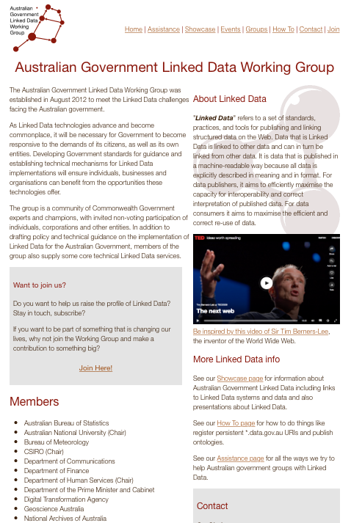
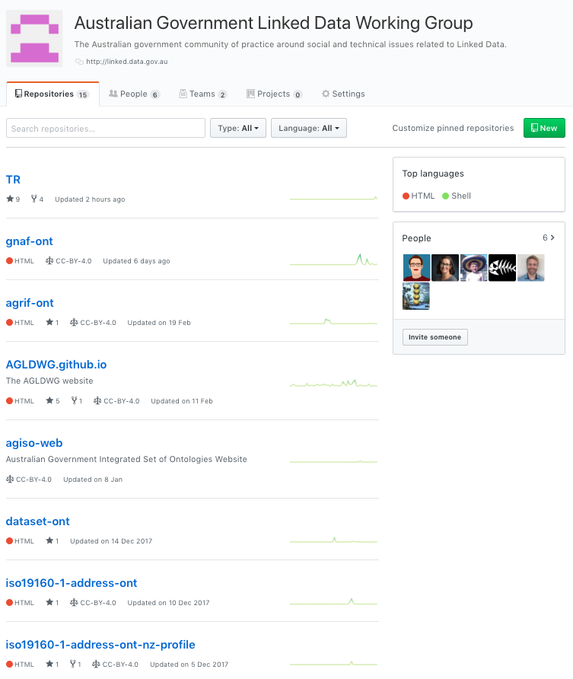
AGLDWG Web Presence
http://linked.data.gov.au
https://github.com/AGLDWG

Slide 12
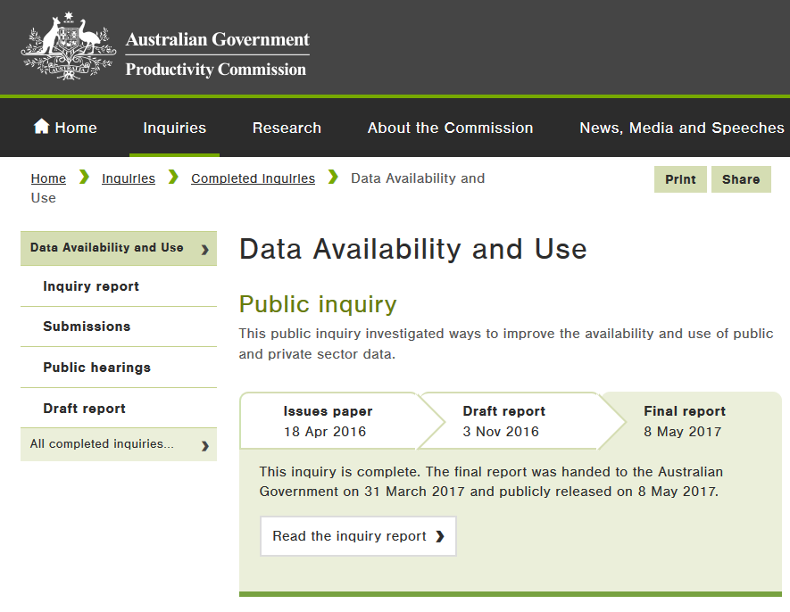
Things the AGLDWG Does
Facilitate the LD community
Engage with WoG data initiatives
Manage linked.data.gov.au namespace
Provide guidelines for establishment of Linked Data resources
Starting to move towards an integrated set of Aut Gov-approved ontologies

Slide 13
Linked Data catalogue
Developing a catalogue of Linked Data
AGISO aims to integrate these and future ontologies allowing them to be used individually or collectively in a seamless way: as if they were one data model
In making this proposal, the AGLDWG steps beyond international precedent regarding government Linked Data initiatives, in that we intend to provide semantic modelling resources and governance, not just guidelines and recommendations for Linked Data publication

Slide 14
Aust Govt Integrated Set of Ontologies (AGISO)
The WG is in the process of developing a proposal for an integrated set of ontologies
Currently, there are several ontologies (e.g. Dataset ontology, AGRIF) being developed with a ‘whole of government’ focus
AGISO aims to integrate these and future ontologies allowing them to be used individually or collectively in a seamless way: as if they were one data model
In making this proposal, the AGLDWG steps beyond international precedent regarding government Linked Data initiatives, in that we intend to provide semantic modelling resources and governance, not just guidelines and recommendations for Linked Data publication

Slide 15
AGISO cont.
Expected methods
A new ontology is submitted:
Proponent should model with AGISO in mind
Proponent must present the ontology to an association testing tool
AT Tool will indicate how, if at all, the ontology’s elements link to the existing AGISO ontologies
Tool assists, but does not complete, compliance processes: links made will be indicative only, human oversight needed
Unlinked classes especially scrutinised to determine reason for non-linking (non-reuse)
WG publishes ontology into AGISO if satisfied with level of reuse

Slide 16
LD Data Integration in Earth Sciences
?
AODN Geographic Extents
DGGS
coastline
?
Nat. Data Catalogues
Geofabric
Statistical Geography
publisher
Au Orgs
(starting July)
wasDerivedFrom
spatial overlay possible
publisher
ACLUMP
GA/National Samples
GA Sites
NEII Sites
sample at
subset
location?

Slide 17
Questions?
Contacts
AGLDWG: http://linked.data.gov.au
Nick: nicholas.car@csiro.au

